Slide 1
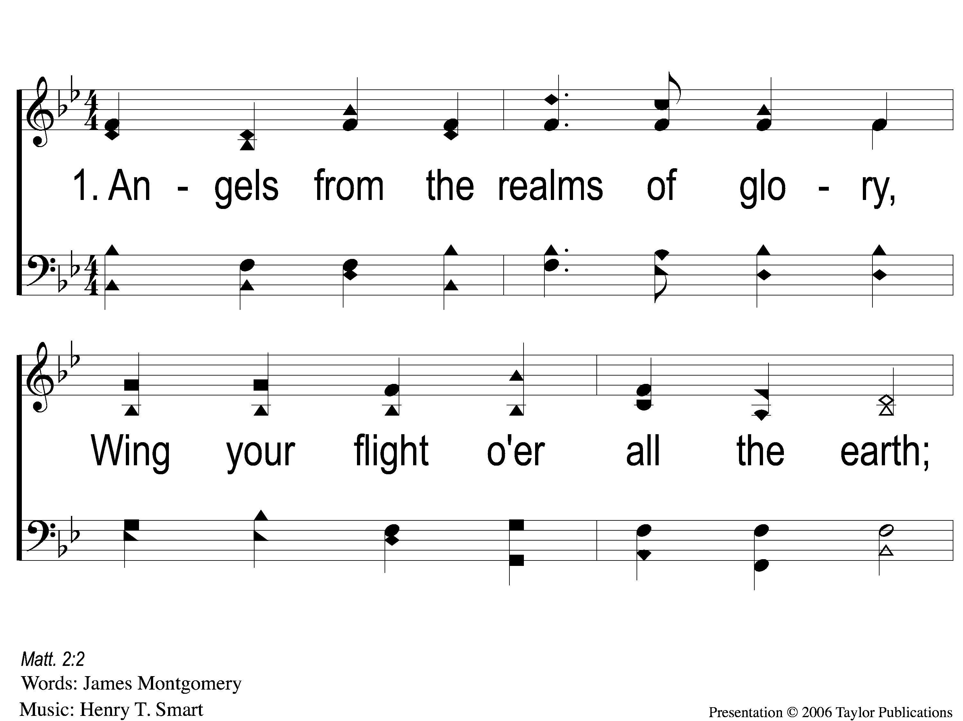
1-1 Angels From the Realms of Glory
Angels From The Realms of Glory
1008

Slide 2
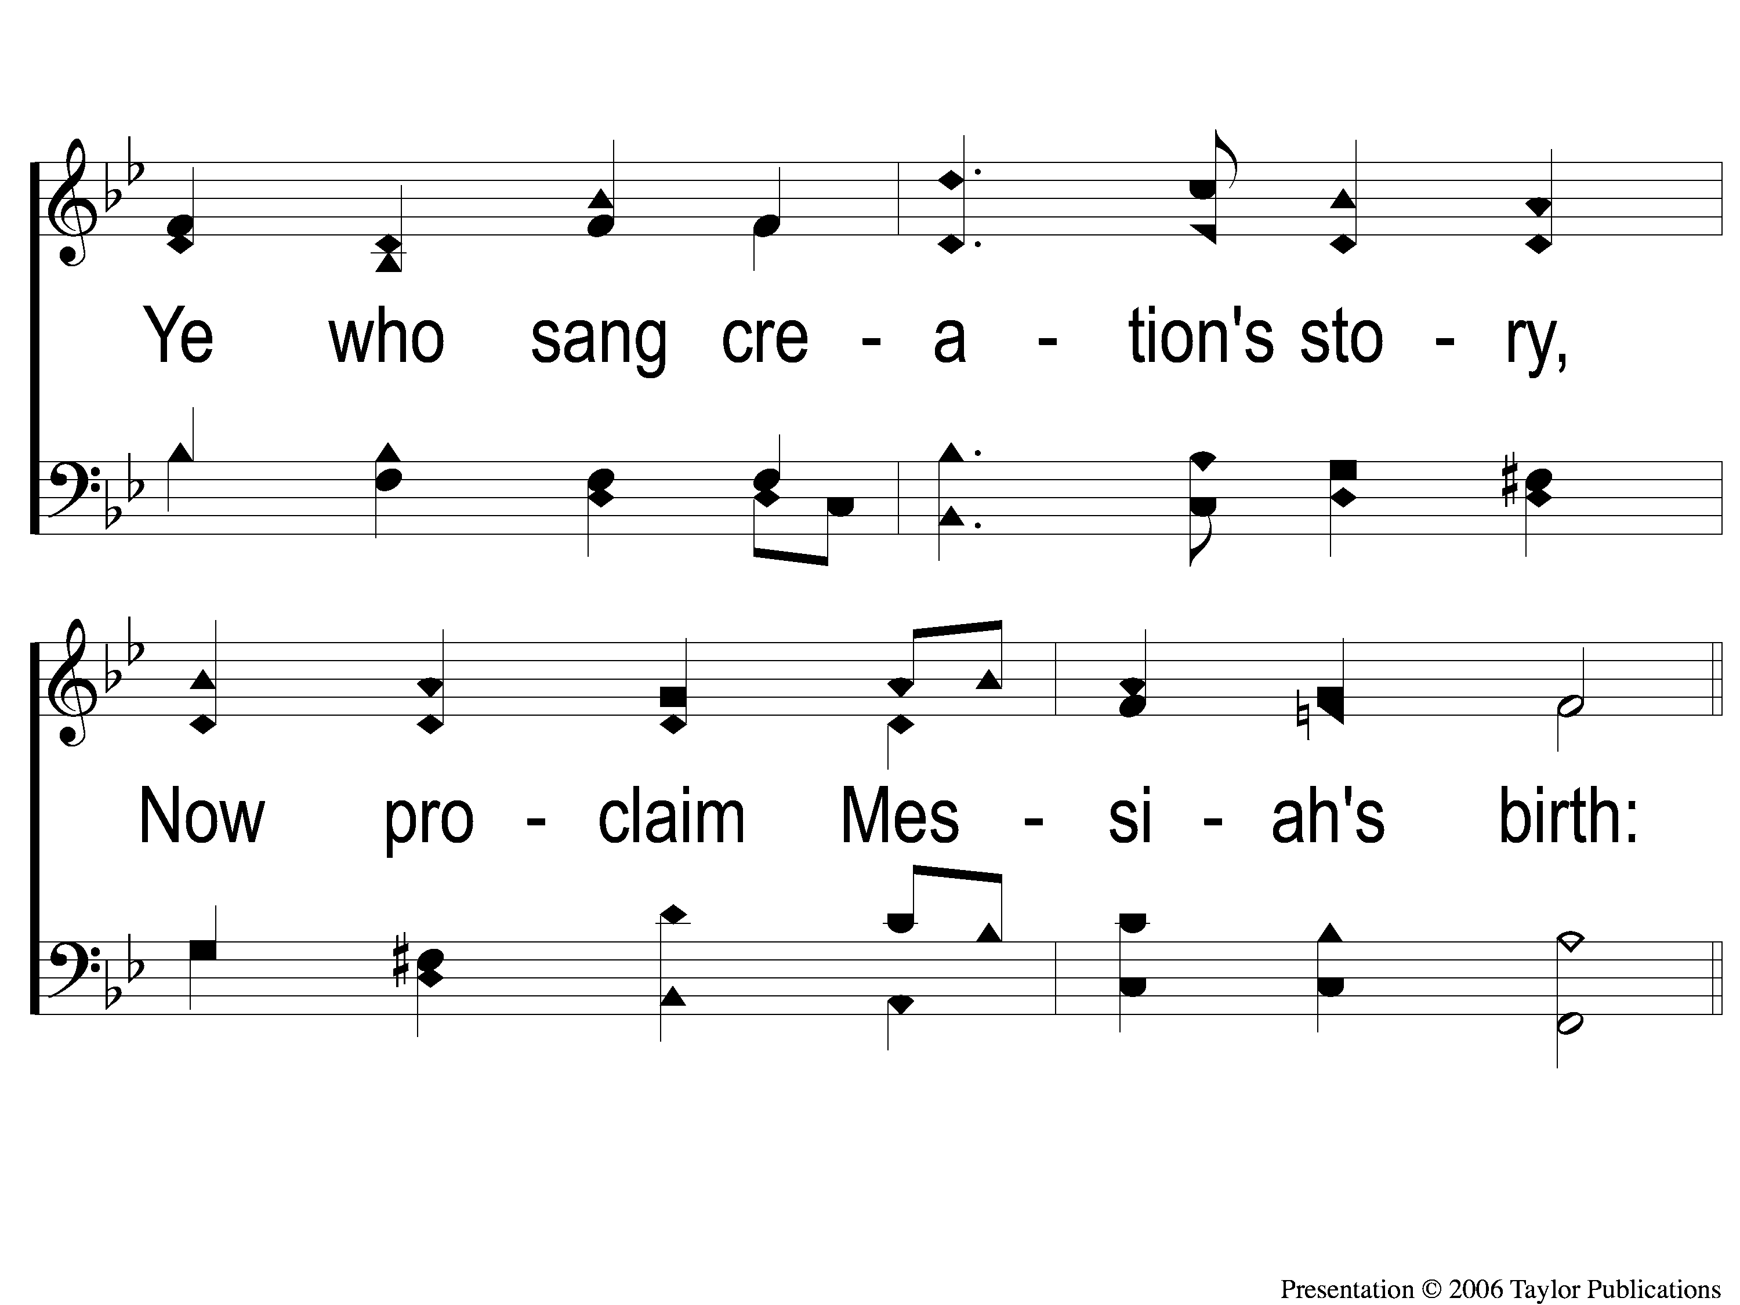
1-2 Angels From the Realms of Glory
Angels From The Realms of Glory
1008

Slide 3
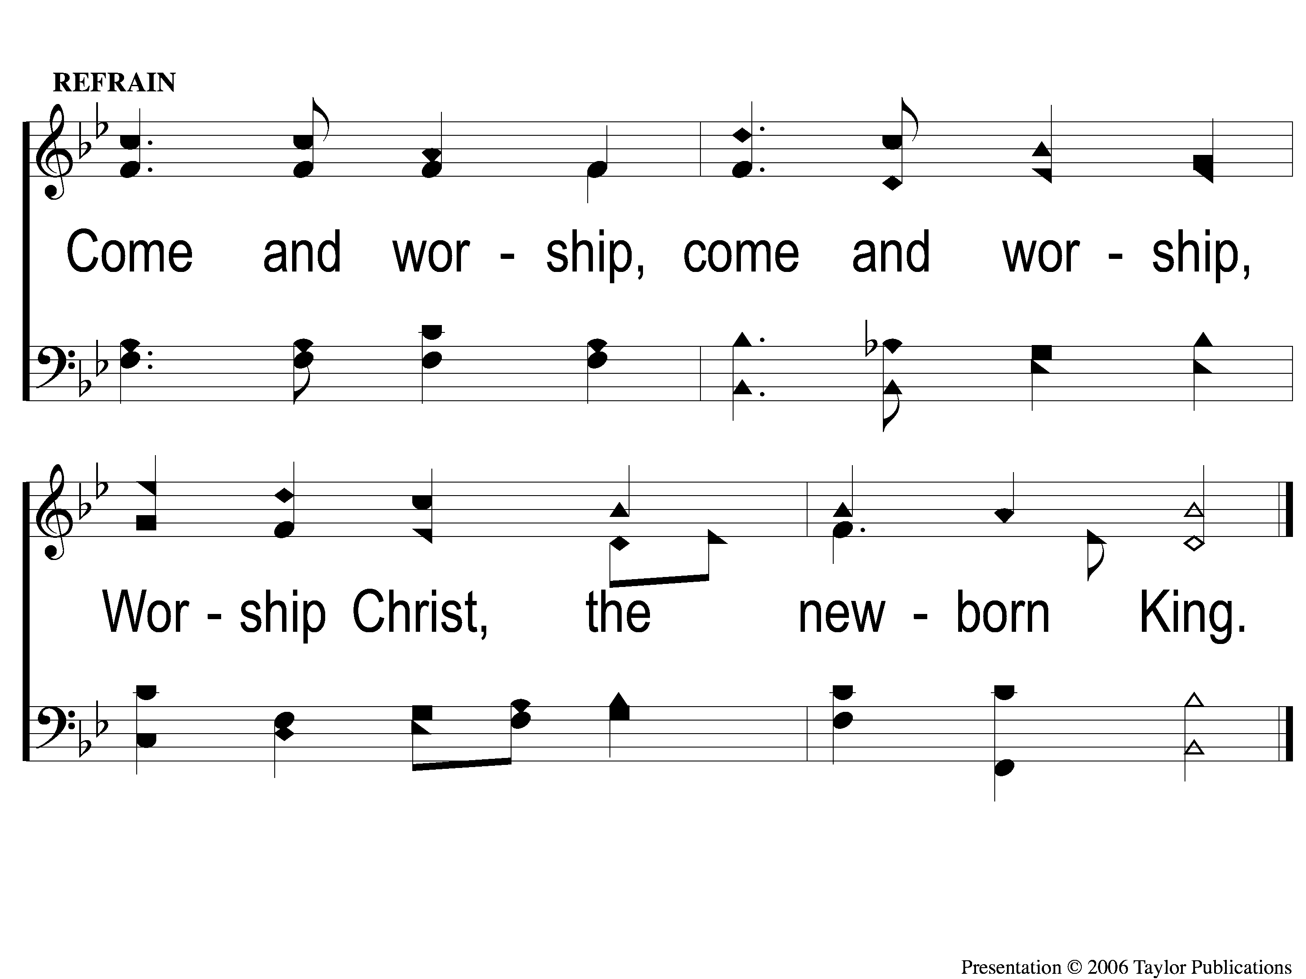
C Angels From the Realms of Glory
Angels From The Realms of Glory
1008

Slide 4
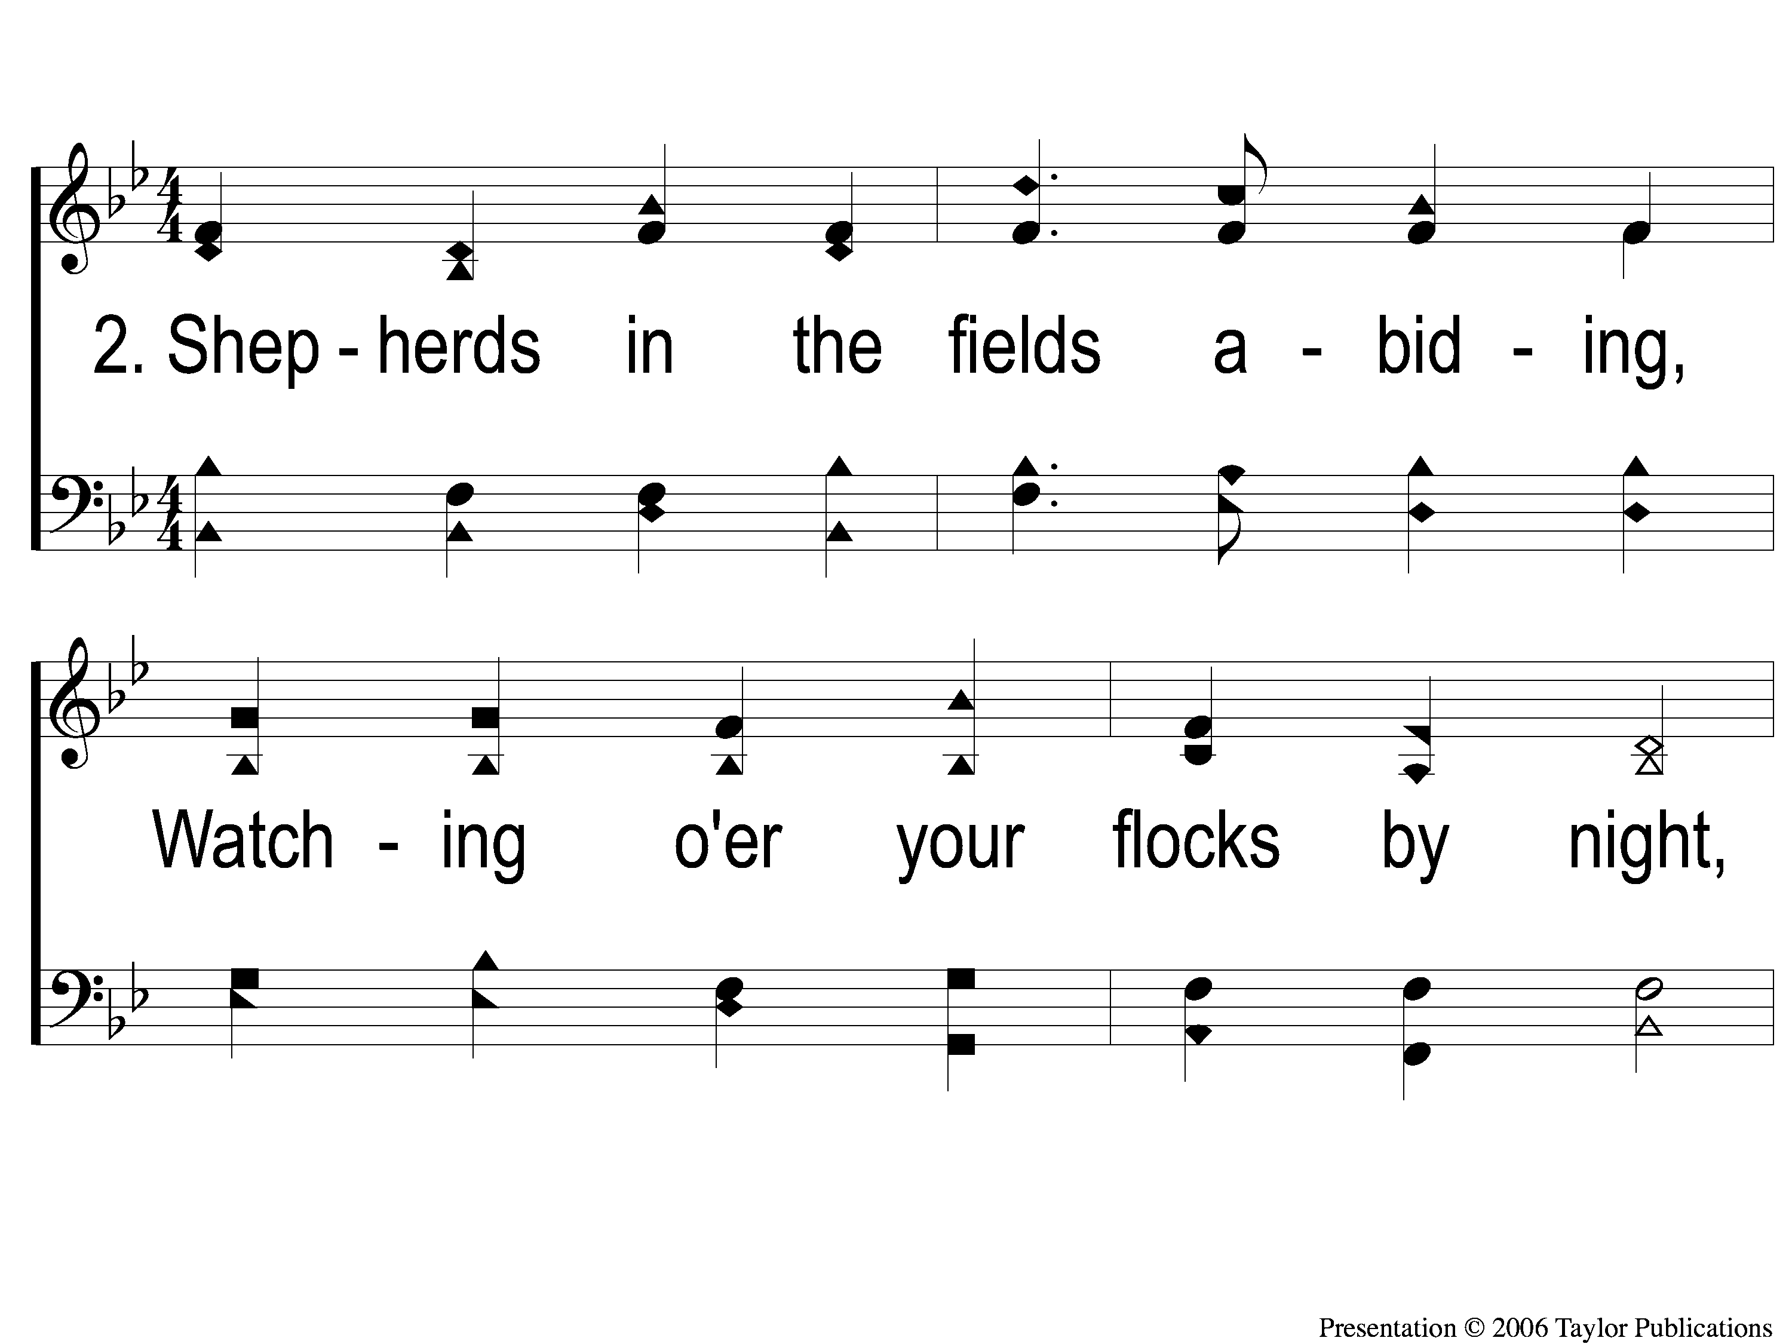
2-1 Angels From the Realms of Glory
Angels From The Realms of Glory
1008

Slide 5
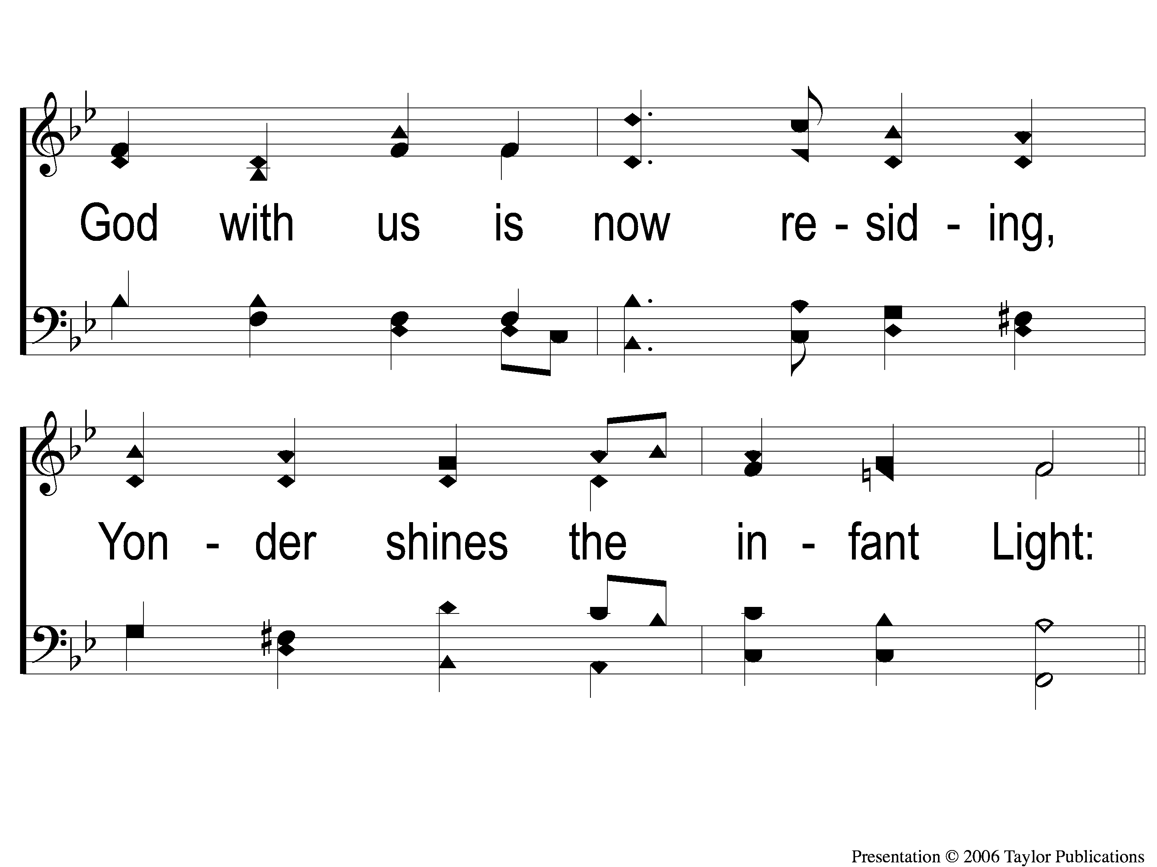
2-2 Angels From the Realms of Glory
Angels From The Realms of Glory
1008

Slide 6
C Angels From the Realms of Glory
Angels From The Realms of Glory
1008

Slide 7
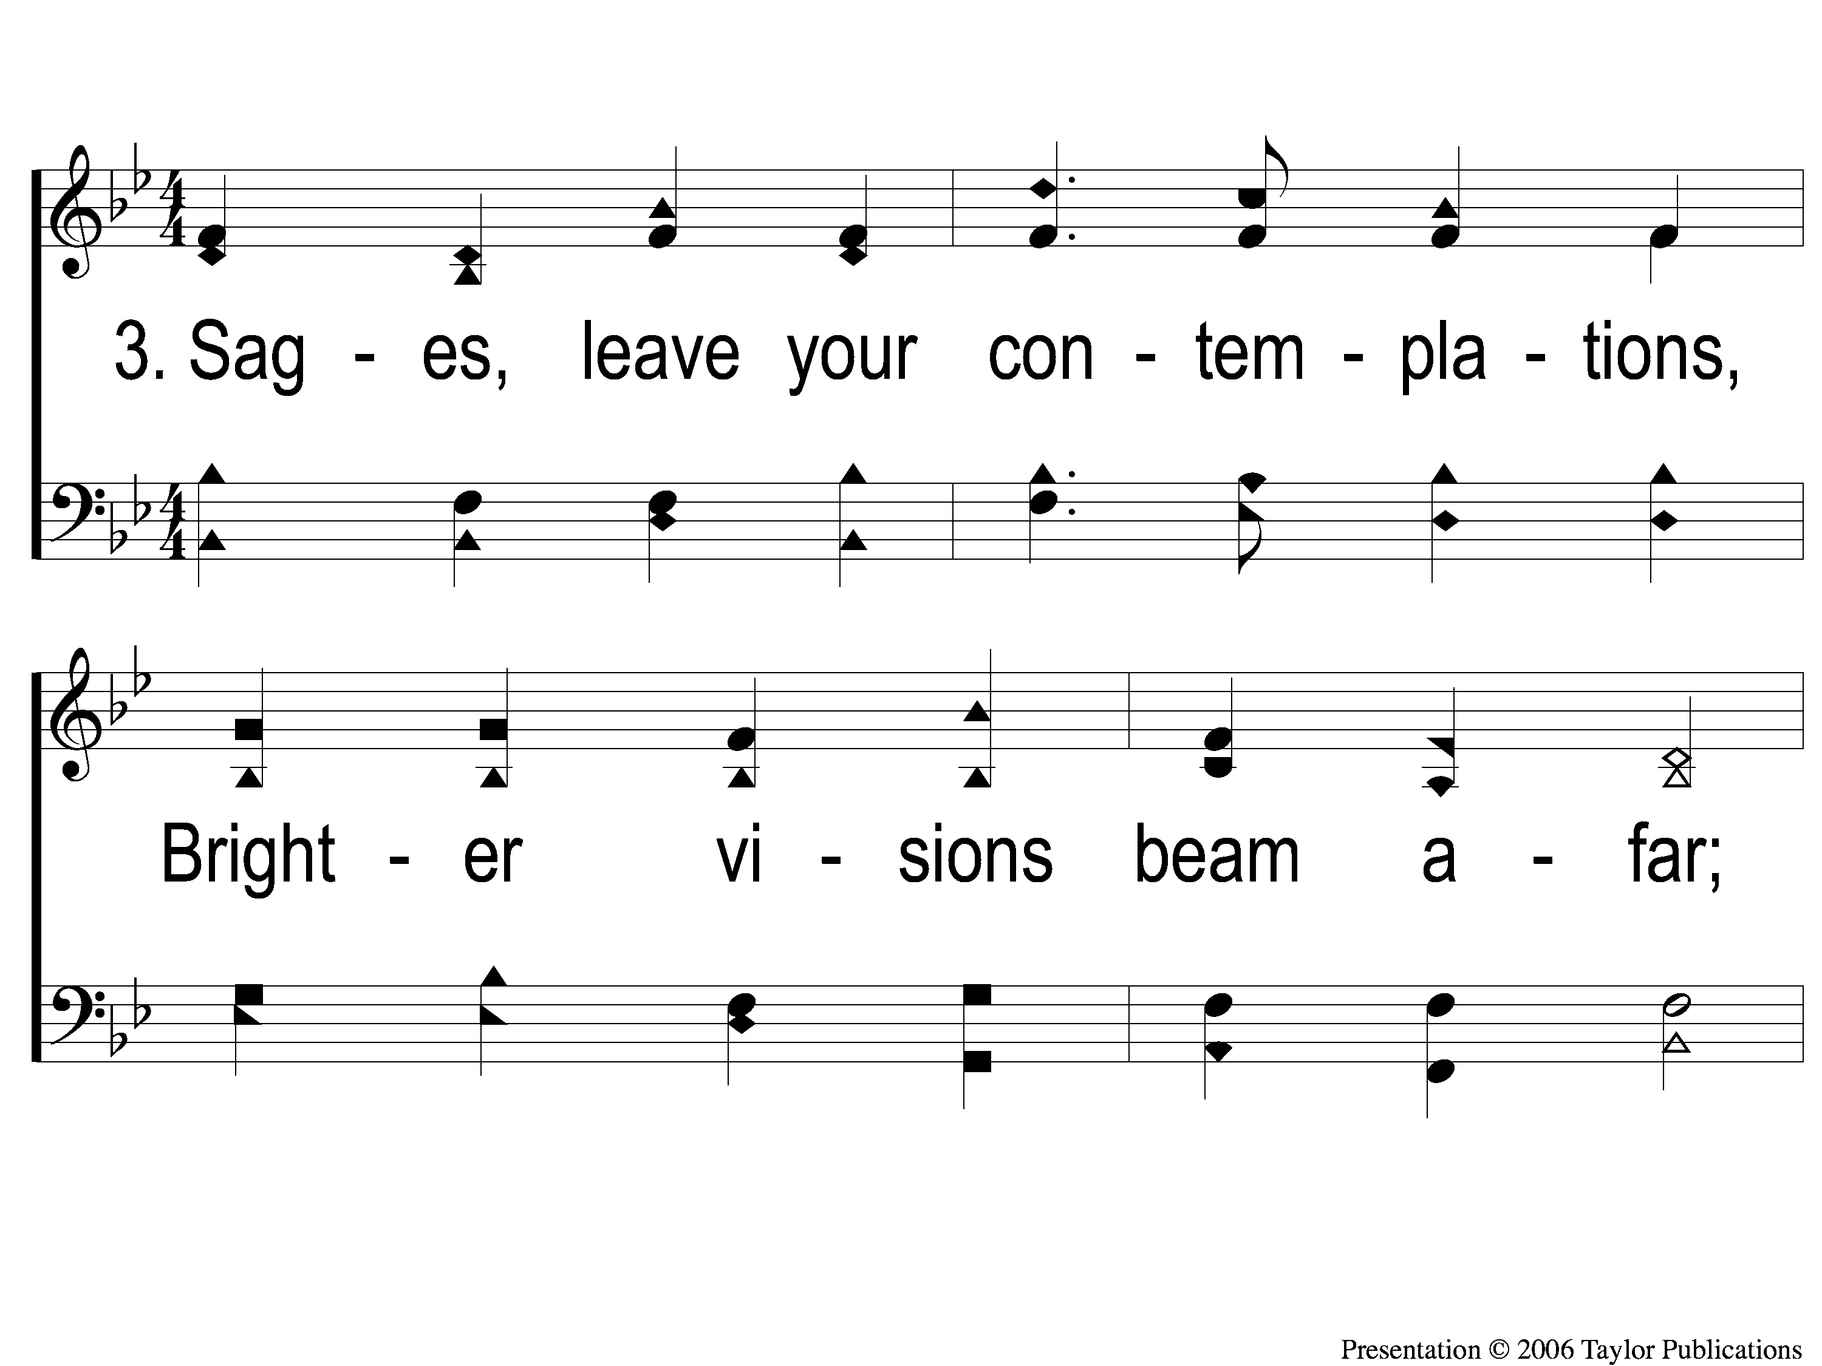
3-1 Angels From the Realms of Glory
Angels From The Realms of Glory
1008

Slide 8
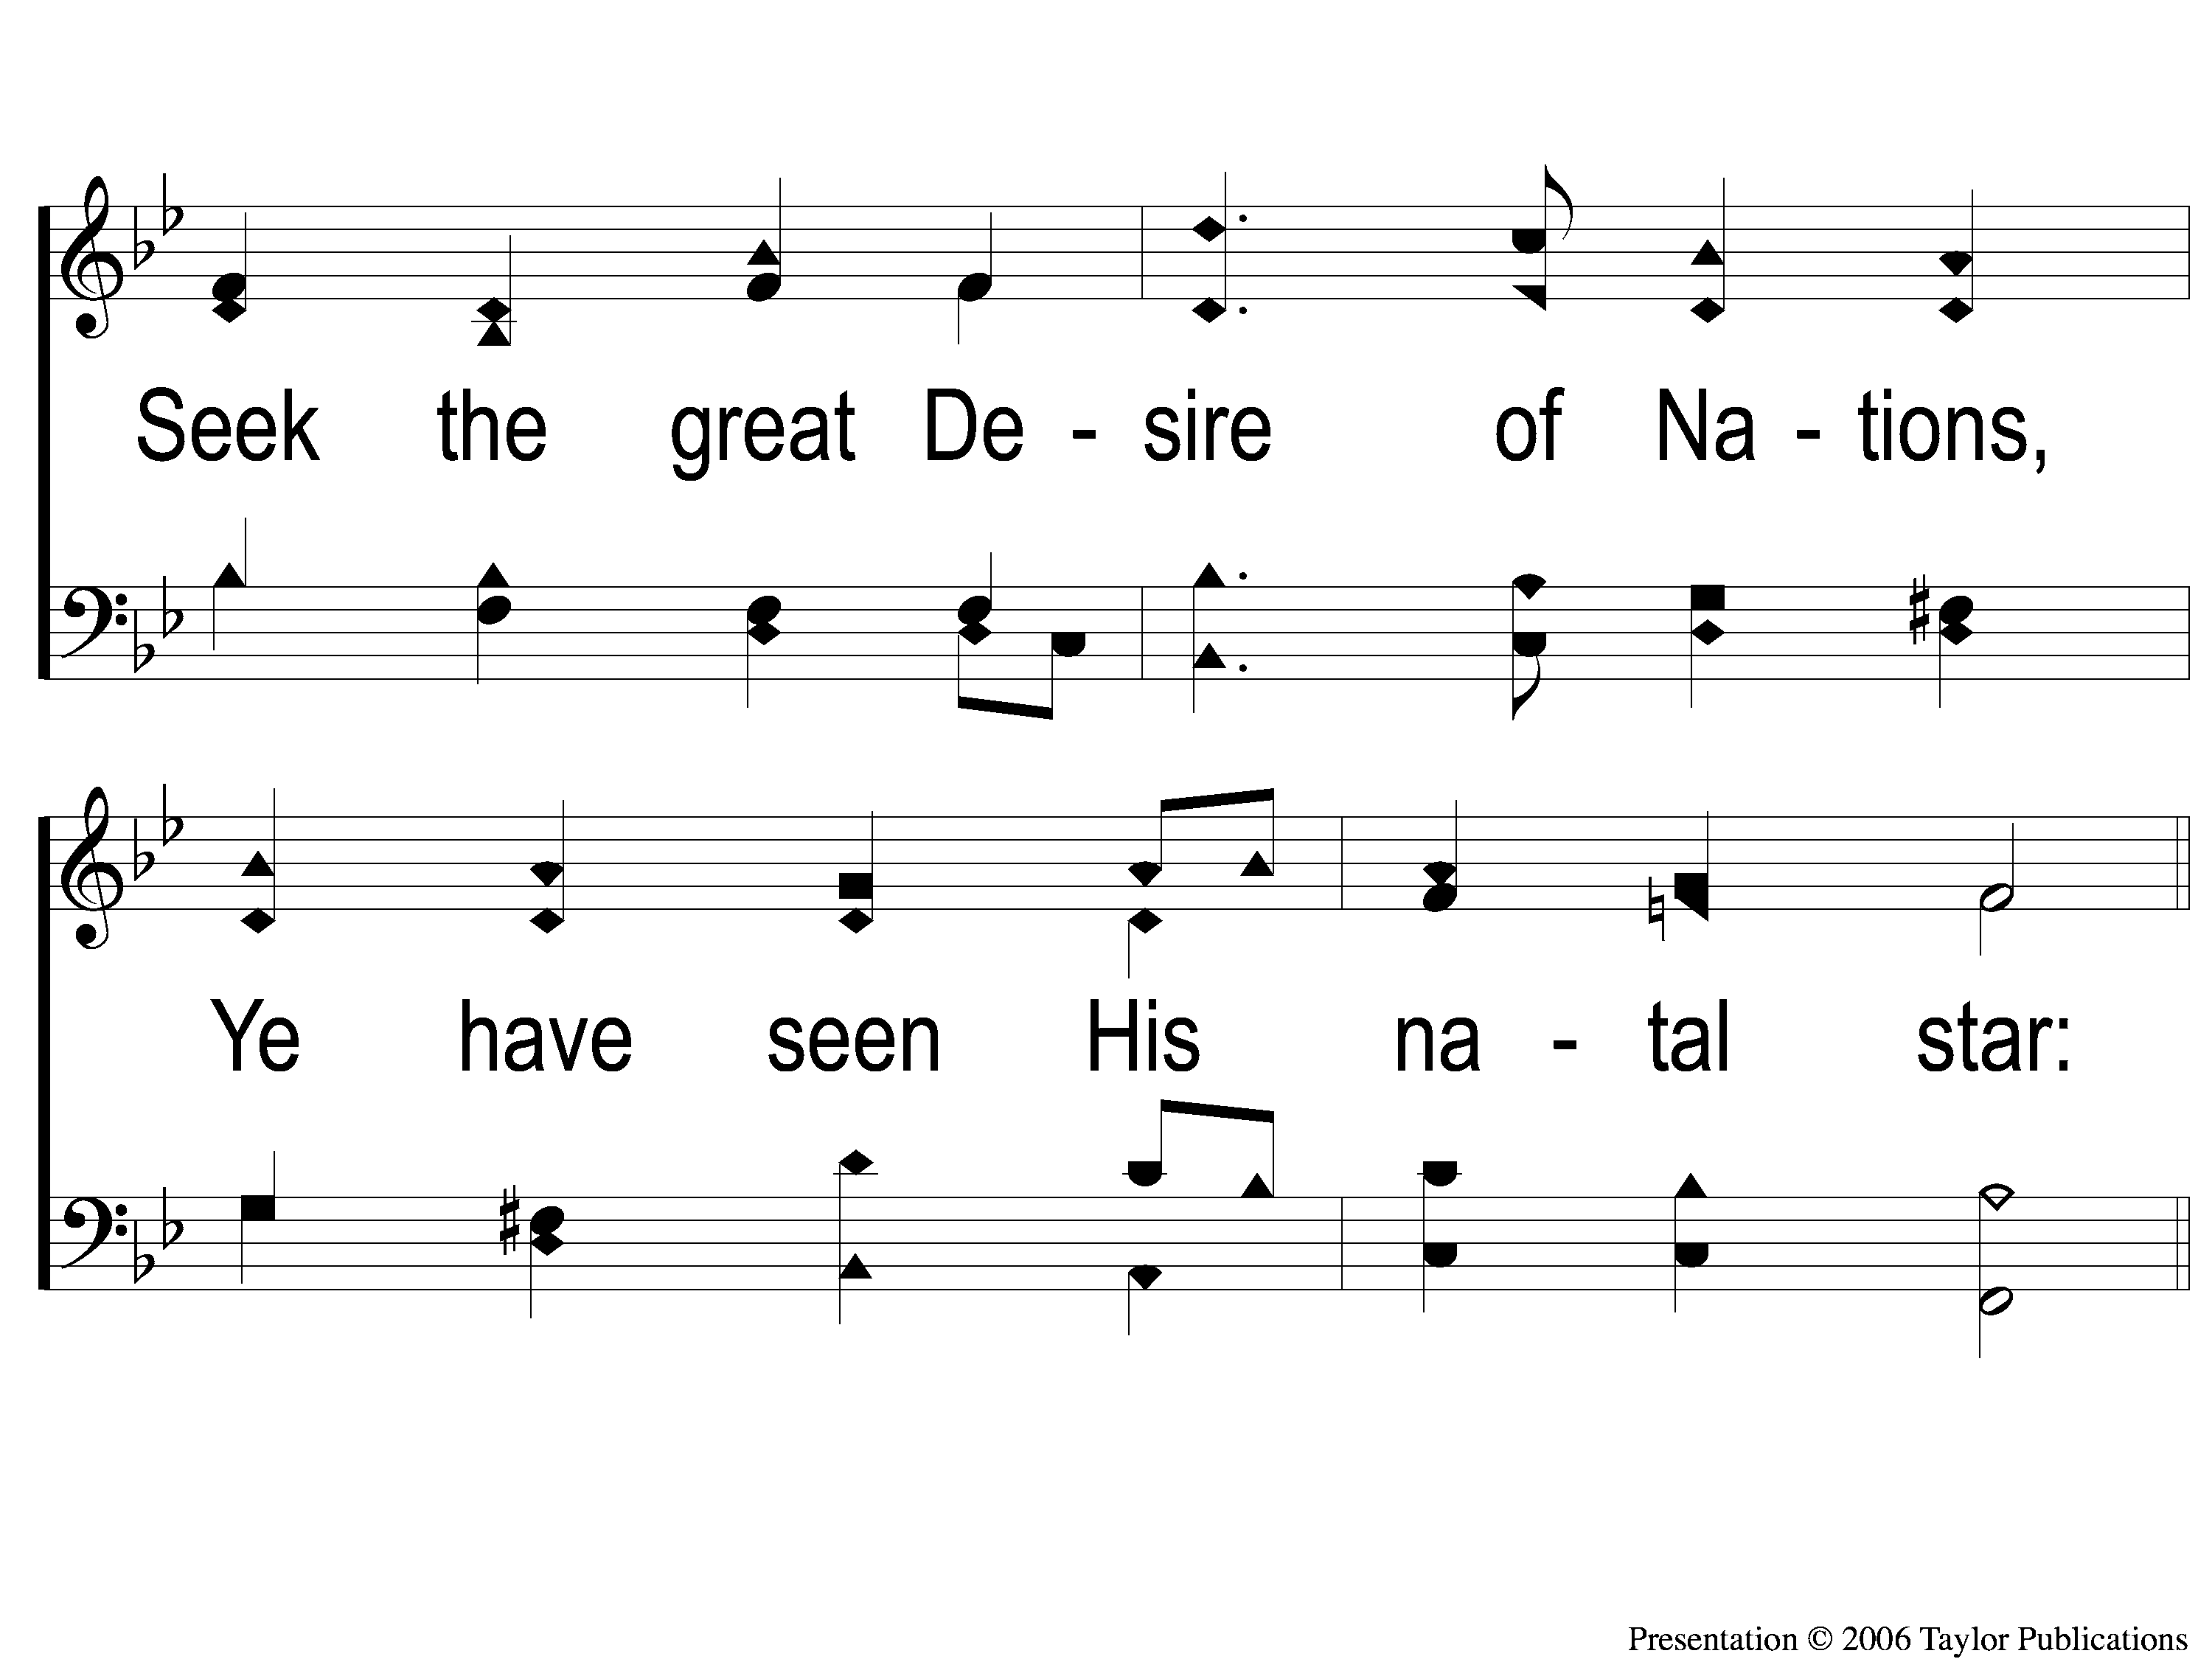
3-2 Angels From the Realms of Glory
Angels From The Realms of Glory
1008

Slide 9
C Angels From the Realms of Glory
Angels From The Realms of Glory
1008

Slide 10
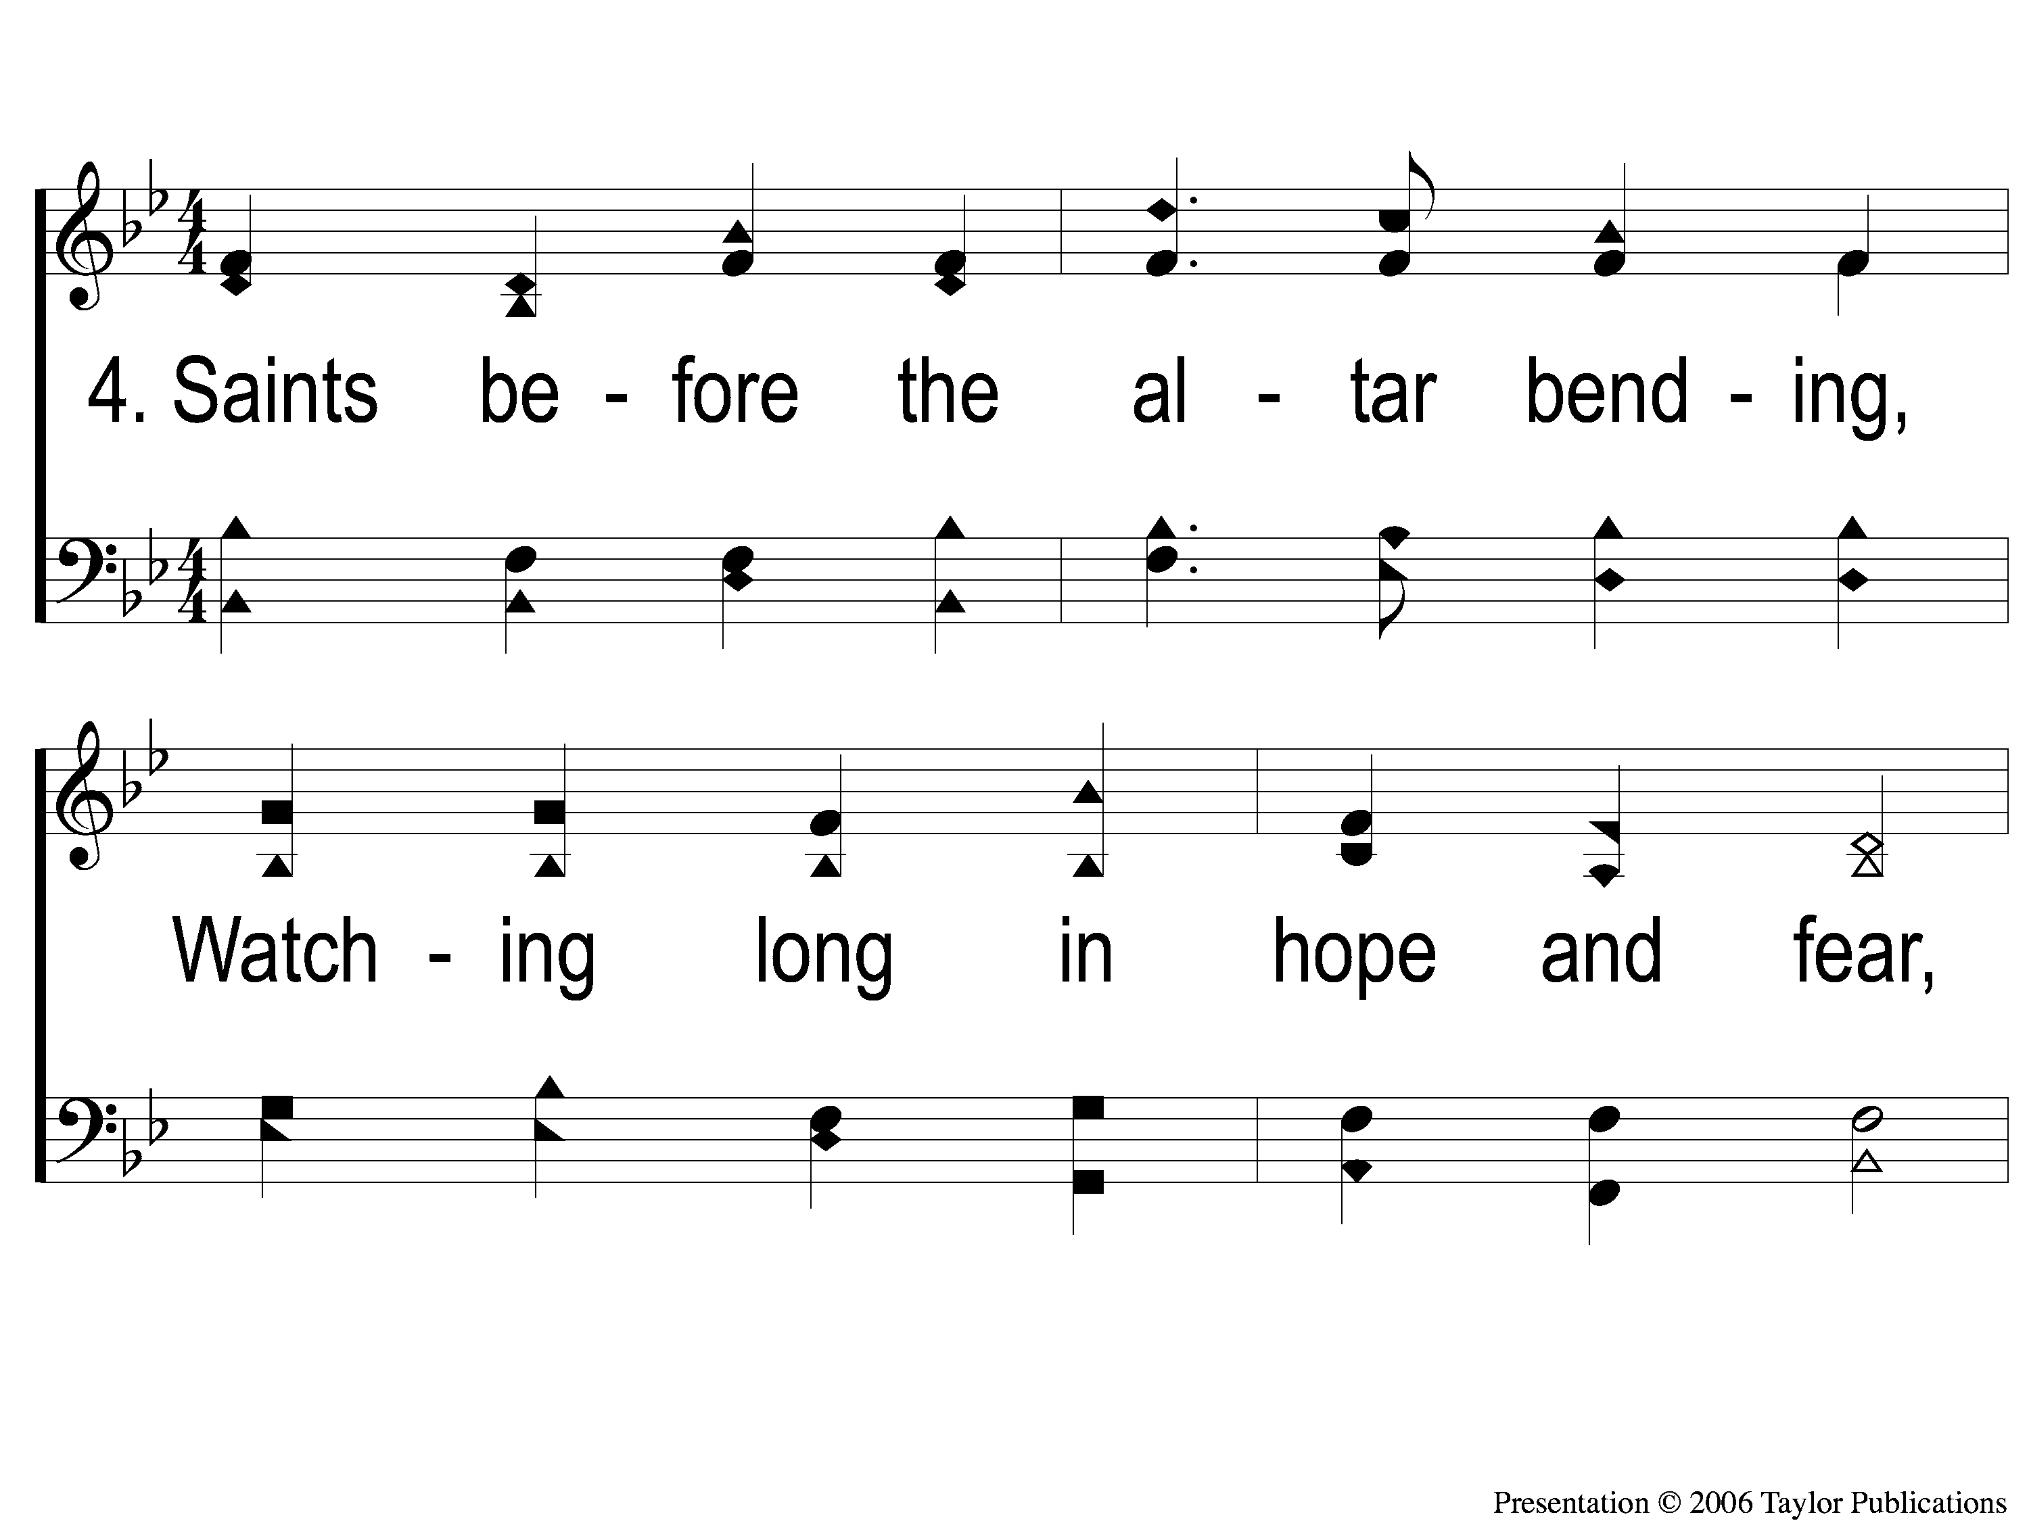
4-1 Angels From the Realms of Glory
Angels From The Realms of Glory
1008

Slide 11
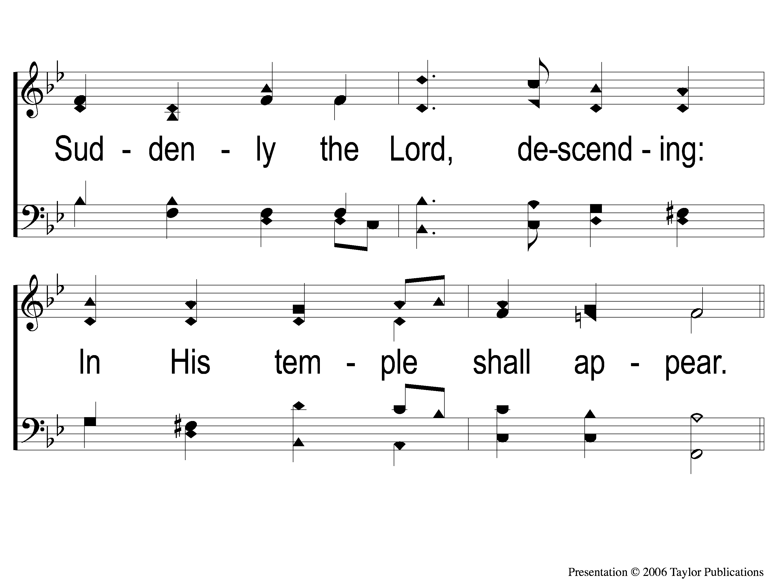
4-2 Angels From the Realms of Glory
Angels From The Realms of Glory
1008

Slide 12
C Angels From the Realms of Glory
Angels From The Realms of Glory
1008

